Slide 1
Qualities of a Leader
Mr. Tanner

Slide 2
Students will be able to understand the importance of modelling good behaviors as a leader
...
1
Lesson Outcome

Slide 3
What does leadership...
1
Look? Sound? Feel Like?

Slide 4
DWYSYWD

Slide 5
Do What You Say You Will Do

Slide 6
Individual Task
Choose 5 of the following values that are most important to you.

Slide 7
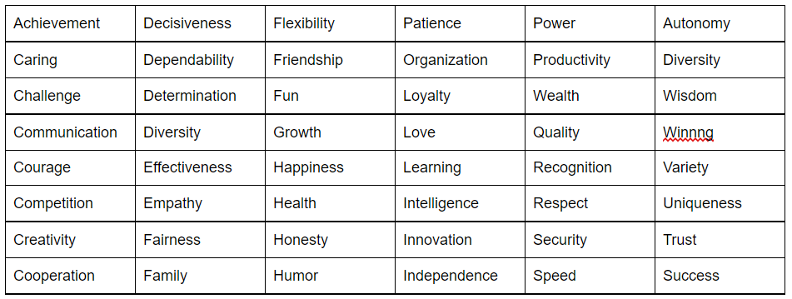
Personal Values
Which 5 are most important to you?

Slide 8
Group Task
On Managebac open your collaborative google doc.
List your 5 values in the first table.
1. As a group, choose 5 that you think are most important to be successful when collaborating.
2. Answer the questions.

Slide 9
Extension:
Why is it important to narrow it down to a few values?

Slide 10
Pay It Forward
CLIP
Discussion: What examples of modelling good behaviour do you see in the video clip?

