Slide 1
Qualities of a Leader
Mr. Tanner

Slide 2
Students will be able to understand ways to enable other group members to succeed.
Lesson Outcome

Slide 3
1. Zoom Activity
1 - 10

Slide 4
Count 1 - 10
Rules
Try to count to 10 together
Can only say one number in a row
If two people speak at same time then start back at 0

Slide 5
Count 1 - 10
Debrief
How did it go?
What strategies worked?
Did every group member contribute?

Slide 6
What does every member of a group contributing...
Sound like?
Look like?
Feel like?

Slide 7
What does uneven group contribution ...
Sound like?
Look like?
Feel like?

Slide 8
It wasn’t my personal best. It was our personal best.
Susan Cohen

Slide 9
Leaders...
Believe in the potential of others
And let them know you do.
Engage the strengths of the group
Recognize values and skills.

Slide 10
Leaders...
Listen to what others say and appreciate what others have to say.
People listen more attentively to those who listen to them.
Can not do it alone
People must have cooperative goals and roles.

Slide 11
Leaders...
Create an environment where people are fully engaged and are in control of their own lives.

Slide 12
Individual Task
📖
Trust Worksheet Reflection

Slide 13
Trust Debrief
1.
What happens when there is a lack of trust?
2.
What is the impact when trust exists?
3.
What behaviours will you focus on to establish trust?

Slide 14
Unit Recap
1.
Model The Way
2.
Inspire a Shared Vision
3.
Challenge The Process
4.
Enable Others to Succeed
5.
?

Slide 15
What ATL skills you can develop will help enabling others to contribute?
Social Skills

Slide 16
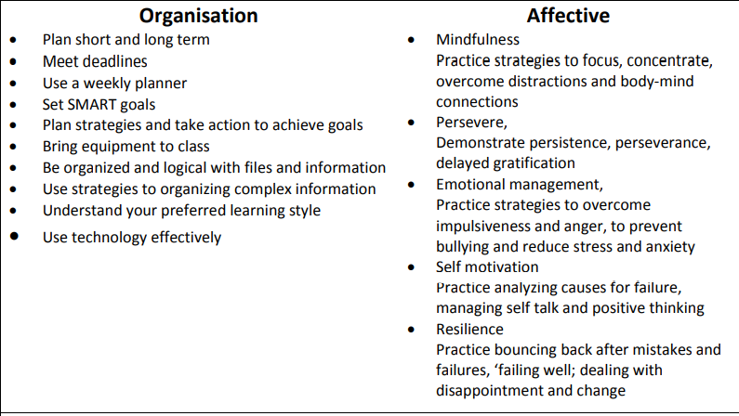
What ATL skills you can develop will help enabling others to contribute?
Self-Management Skills

